Slide 1
AquaSense
Real-Time Water Use Monitoring
Carlton Duffett Amir Soltanianzadeh
Louis Kim
Michael Zhu
Notes:
Slides:
1 - (Group) title slide
2 - (Carlton) introduction
3 - (Carlton) overview
4 - (Amir) opportunity
5 - (Louis) solution
6 - (Carlton) intelligent platform
7 - (Carlton) how it works
8 - (Michael) our secret sauce
9 - (Carlton) competition
10 - (Amir) market strategy
11 - (Amir) financials
12 - (Amir) funding
13 - (Amir) summary

Slide 2
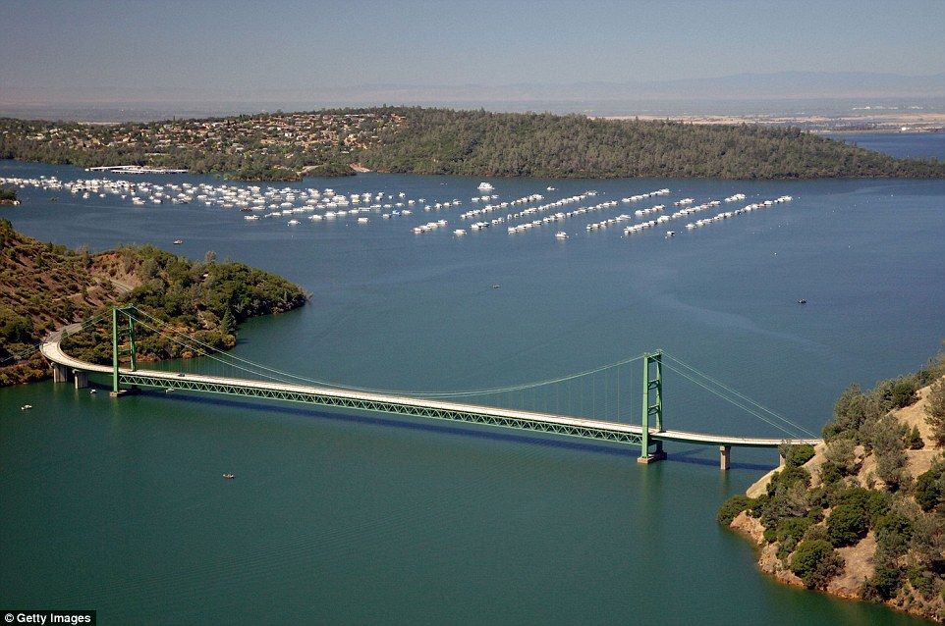
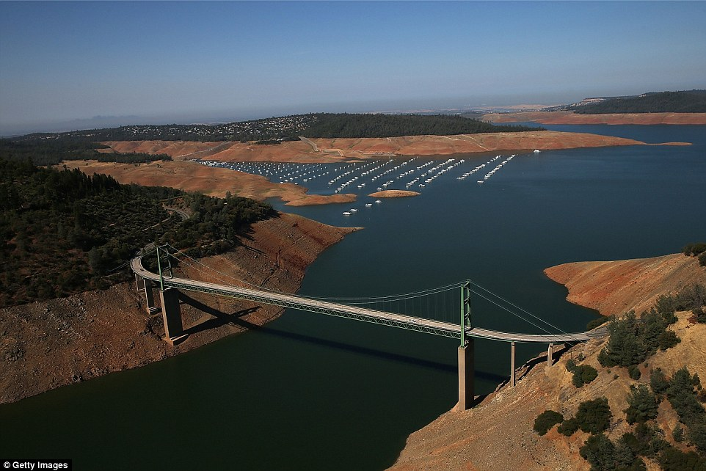
The Water Problem
Notes:
Carlton
Green Bridge, Lake Oroville
before - 2011
after - 2014 (last summer)
There is a real and growing water problem in the United States and abroad.
Water is growing scarcer and more expensive.
This poses a problem for consumers who are experiencing water shortages and drought.

Slide 3
Company Overview
AquaSense is an intelligent platform that
monitors your water use in real-time, helping you save money before you get your bill.
Affordable | Easy to Use | Eco-Friendly
Notes:
Carlton
Our solution to the water problem:
intelligent platform that monitors total home water use in real time.
We show you how much money your water use is costing you BEFORE you get your monthly bill
This saves consumers from the pain of high water prices and helps them adjust their water use habits
Entire municipalities benefit from our product

Slide 4
Our Opportunity
Water is increasingly scarce and expensive
Consumers pay for what they don’t know
Monthly water bill = uninformative / too late
Current Market: homeowners, small businesses
~15M people = $1.5 Billion market
Drought-stricken areas
High/increasing water prices
Eco-friendly
Future Markets: apartments, farmers
Notes:
Amir
Our opportunity:
water will only become scarcer and more expensive over time
Monthly water bill comes too late to help you change your habits or save money - this costs the consumer $$$
Large, untapped market:
everyone uses water
huge potential in drought stricken areas
our product appeals to eco-friendly and tech-savvy types

Slide 5
Our Solution
Real-time, personalized monitoring
Affordable - pays for itself
Intelligent: Learns user’s consumption habits
Informs them how to:
Conserve water
Save money
Save the environment
Notes:
Louis
Our solution:
real-time, personalized monitoring of the total water flow into your home
affordable, pays for itself within a year; less if subsidized
intelligent: learns your water use patterns, helping us make informed suggesting for how to improve your water use
Our goal is to help consumers:
conserve water
save money
save the environment

Slide 6
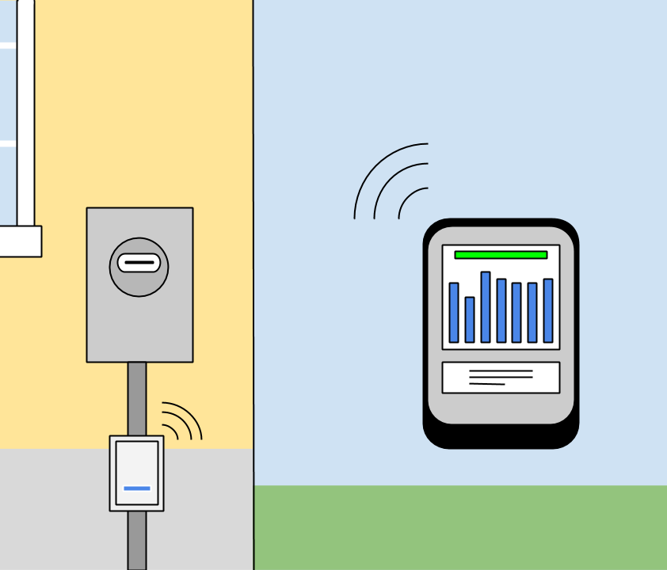
The Intelligent Platform
Wireless sensor box streams real-time flow data to the cloud
Intelligent application learns your water use habits and helps you establish good trends
Alerts you to abnormal water flow that could be from a disastrous leak!
Notes:
Carlton
The intelligent platform:
wireless sensor box that takes real-time flow readings
intelligent mobile application that learns your water use habits and provides suggestions for saving water
Long-term benefits:
Alerts you to abnormal water flow that could come from costly leakages
(Nest does a similar thing with smoke detectors - insurance companies love this stuff!)
Mention advertising

Slide 7
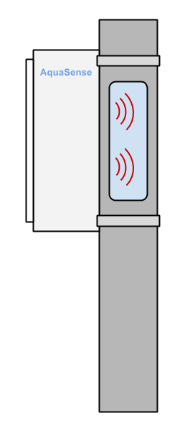
How it Works
Ultrasonic sensors require no invasive cutting or professional installation
Attaches to the main water line in your home, measuring aggregate usage
Teach your sensor to recognize each major source of water use in your home
Notes:
Carlton
ultrasonic sensors that measure the speed of particles in the water
measures total water flow into your home
but… can train the sensor box to recognize major sources of water consumption
(ex - train to recognize your shower, sprinkler, kitchen sink, etc.)

Slide 8

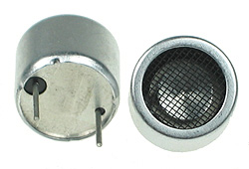
Our Competitive Edge
Cutting-edge intelligent platform
Easy to use, non-invasive technology
Most affordable ultrasonic technology on the market
Notes:
Michael, just read the bullet points to summarize our product:
“To summarize, we have a cutting-edge intelligent platform coupled with affordable, very easy-to-use technology. Think of us as Nest in the smart water market.”

Slide 9
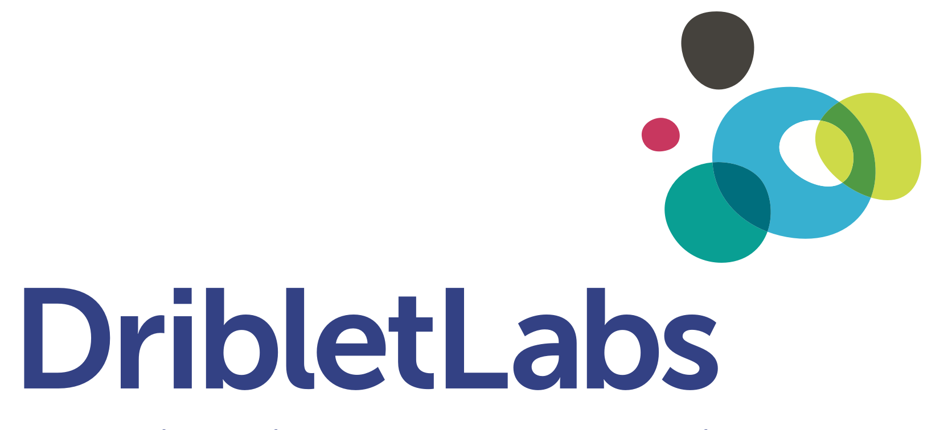




Competition
AquaSense
 | Elster | Aquiba | Driblet | AquaSense
Price
Product
Platform
Notes:
Carlton
No market is without competition, but ours is weak:
Elster - large German Company specializing in smart water meters
they offer a cheap product that takes the place of conventional meters
but they present only raw data to their users. They have no intelligent platform.
Requires professional installation.
Aquiba - British company manufacturing ultrasonic flow meters. Their product uses
similar technology but is 10x as expensive. Only practical in industrial applications
No user interface, requires professional installation
Driblet - our closest potential competitor, but still a ways off. They offer a similar cloud-based
platform, but their product is limited to measuring flow through only one device at a time,
such as a showerhead. Easy enough for the homeowner to install, but still challenging
We are everything our competitors aren’t - we have the price, product, and the platform

Slide 10



Our Market Strategy
Market in regions with large suburban populations, drought, or expensive water
Debut in California
Sell our product:
directly from our website
through online retailers
home goods stores
Notes:
Amir
Market strategy:
market in regions with expensive water, a lot of people living in single family homes, and regions with drought
Our product’s benefits are most tangible in areas with drought, but also practical in places with expensive water
Go to market:
we plan to debut in California ASAP - best potential to attract customers there
(lots of tech savvy, environmentally conscious, smart home loving types)
Sell through the usual channels:
directly
through online retailers
home goods stores (lowes, home depot, best buy)

Slide 11
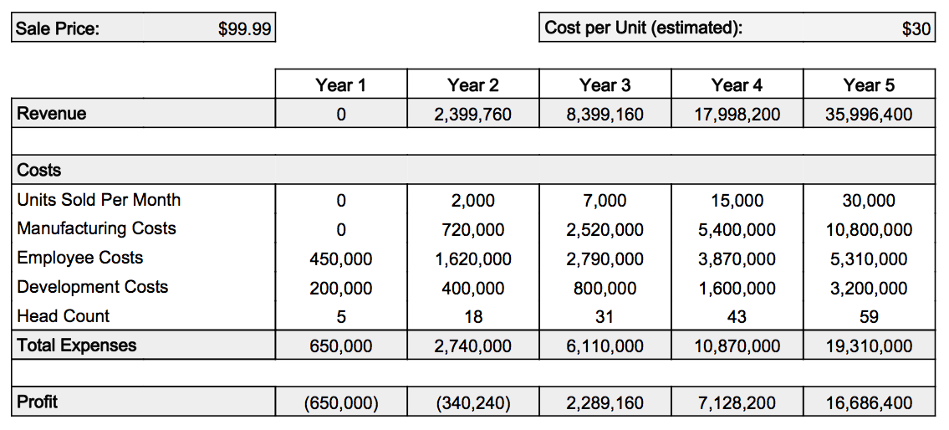
Financial Plan
Notes:
Amir
Part of our revenue also comes from product placement and advertising within our app
We can point users to products that can help them save even more money, and water
In year 5, Nest is selling 80,000 units per month in a similar space
Demand for these kind of products is real, we think we have a huge, untapped market in front of us

Slide 12
Funding
What we need now:
$1 million - Seed funding gets us to a
prototype and market-ready scale
1 year from now:
$3 million - Series A funds our launch
and growth
Notes:
Amir
To get our product out we need $1M series A funding
This gets us a proven product and all of the leg work needed to launch into our market
Series B funding feeds that launch and helps us grow with demand

Slide 13
In Summary
Why we’re different
Unparalleled technology and a cutting-edge intelligent platform
Why we’ll win
Easy to use, affordable product with no appealing competition
Why you should invest
Early entrants in a new market that has a rapidly growing problem
Notes:
Carlton
Just summarize everything. basically read the bullet points

Slide 14
Questions?

Slide 15
Cost Breakdown
Description of Key Components | Cost (USD)
TI cc2590 wireless RF transceiver and MCU | 1.98
Futurlec waterproof ultrasonic sensors | 3.90
Molex Inc wireless RF antenna | 2.06
TI TLC7701 power control unit | 0.63
Plastic ABS enclosure | 1.00
AA battery holder | 0.85
Mounting hardware | 0.79
Conservative Estimated Cost of Materials | $15.00
Manufacturing cost: additional $10/unit (est)

Slide 16
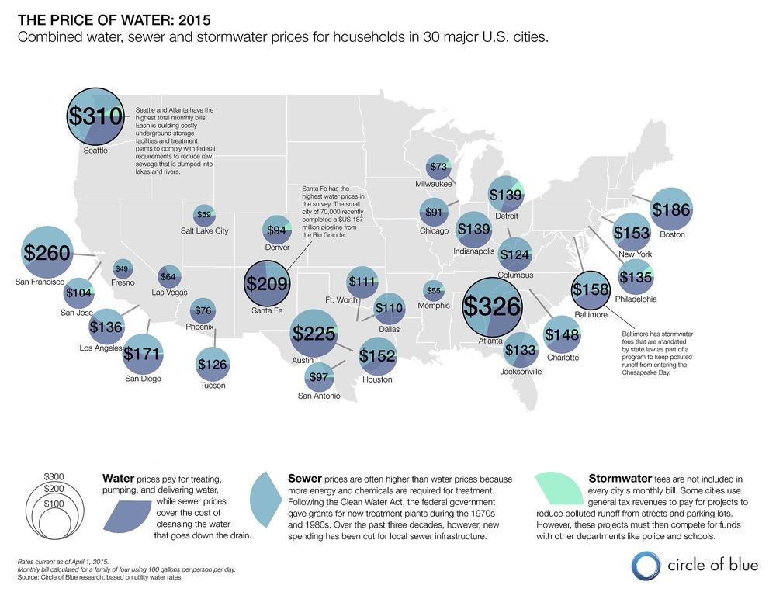
Notes:
Appendix for areas with high water prices (not just california)

Slide 17
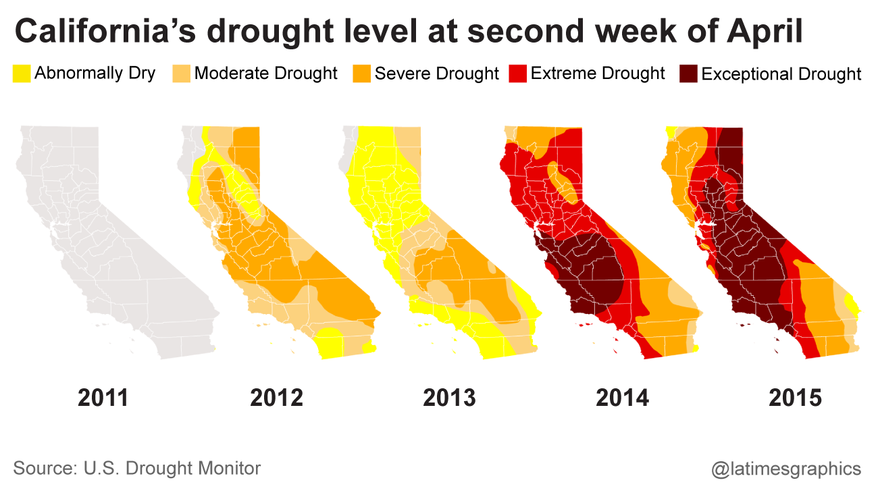
Notes:
Severe californian drought

